Slide 1
MODULE - 3

Slide 2
Dynamic Data Structure Linked List: Types, Introduction to Singly Linked lists: Representation of Linked Lists in Memory, Traversing, Searching, Insertion & Deletion from Linked List. Doubly Linked List, Operations on Doubly Linked List (Insertion, Deletion, Traversal). Applications: Polynomial Representation & Basic Operations, Stack & Queue Implementation using Linked Lists

Slide 3
Dynamic data structure
Kind of data structure that changes its size during runtime.
A dynamic data structure (DDS) refers to an organization or collection of data in memory that has the flexibility to grow or shrink in size, enabling a programmer to control exactly how much memory is utilized.

Slide 4
Need of Dynamic DS
In array, elements are stored in consecutive memory locations.
To occupy the adjacent space, block of memory that is required for the array
should be allocated before hand.
Once memory is allocated, it cannot be extended any more. So that array is
called the static data structure.
Wastage of memory is more in arrays.
Array has fixed size
But, Linked list is a dynamic data structure, it is able to grow in size as
needed.

Slide 5
Static and Dynamic DS
Static Data structure
Dynamic Data Structure
Only alter the data present in the data structure at runtime
Pre-define or calculate the size of the data structure
Both the data present in the data structure and the size of the data structure can be easily changed
We can easily increase the size of the data structure at the runtime of the program execution.

Slide 6
Dynamic DS - disadvantage
Issue with memory consumption.
Always a potential chance of memory overflow and underflow

Slide 7
Dynamic DS
Singly Linked List
Doubly Linked List
Circular Linked List
Representing Stack with Linked List.
Representing Queue with Linked List.

Slide 8

What is Linked List?
A Linked list is a linear collection of homogeneous data elements, called nodes, where linear order is maintained by means of links or pointers.
Each node has two parts:
The first part contains the data (information of the element) and
The second part contains the address of the next node (next /next pointer field) in the list.
Data part of the next can be an integer,
a character, a String or an object of any kind.

Slide 9
node
next
data
Address of
next node
Address of
next node
Address of
next node
Start
Null
Header pointer
A
B
C
D

Slide 10
Linked Lists
Linked list
Linear collection of self-referential structures, called nodes, connected by pointer links.
Accessed via a pointer to the first node of the list.
Subsequent nodes are accessed via the next-pointer member stored in each node.
next pointer in the last node is set to null to mark the end of list.
Data stored dynamically – each node is created as necessary.
Length of a list can increase or decrease.
Becomes full only when the system has insufficient memory to satisfy dynamic storage allocation requests.

Slide 11
Types of Linked lists
Singly Linked list
Begins with a pointer to the first node
Terminates with a null pointer
Only traversed in one direction
Circular, singly linked list
Pointer in the last node points back to the first node
Doubly linked list
Two “start pointers”- first element and last element
Each node has a forward pointer and a backward pointer
Allows traversals both forwards and backwards
Circular, doubly linked list
Forward pointer of the last node points to the first node and backward pointer of the first node points to the last node

Slide 12
Dynamic Memory Allocation
Dynamic memory allocation
Obtain and release memory during execution
malloc
Takes number of bytes to allocate
Use sizeof to determine the size of an object
Returns pointer of type void *
A void * pointer may be assigned to any pointer
If no memory available, returns NULL
newPtr = malloc( sizeof( struct node ) );
free
Deallocates memory allocated by malloc
Takes a pointer as an argument
free (newPtr);

Slide 13
Self-Referential Structures
Self-referential structures
Structure that contains a pointer to a structure of the same type
Can be nexted together to form useful data structures such as lists, queues, stacks and trees
Terminated with a NULL pointer (0)
Two self-referential structure objects nexted together
15
10
Data member and pointer
NULL pointer (points to nothing)

Slide 14
Singly Linked list operations
Insertion:
Insertion of a node at the front
Insertion of a node at any position in the list
Insertion of a node at the end
Deletion:
Deletion at front
Deletion at any position
Deletion at end
Display:
Displaying/Traversing the elements of a list

Slide 15
Singly Linked lists
Node Structure
struct node
{
int data;
struct node *next;
}*new, *ptr, *header, *ptr1;
2000
new
data
next
10
NULL
Creating a node
new = malloc (sizeof(struct node));
new -> data = 10;
new -> next = NULL;
2000

Slide 16
Inserting a node at the beginning
Create a node that is to be inserted
2500
new
data
next
Algorithm:
Create a new node.
if (header = = NULL)
header = new;
else
{
new -> next = header;
header = new;
}
10
NULL
2500
If the list is empty
NULL
header
header
If the list is not empty
1200
2500
header
new
5
1300
5
1330
4
1400
8
NULL
10
NULL
1200
1300
1330
1400
2500

Slide 17
Inserting a node at the end
header
1500
10
1800
20
1200
30
1400
40
NULL
2000
1500
1400
1800
1200
ptr
50
NULL
1800
1400
1500
1200
2000
Algorithm:
new=malloc(sizeof(struct node));
ptr = header;
while(ptr -> next!= NULL)
ptr = ptr -> next;
ptr -> next = new;
new
2000

Slide 18
Inserting a node at the given position
header
ptr
1800
Insert position : 3
1500
1500
10
20
1200
1800
2000
30
1400
40
NULL
1500
1400
1800
1200
50
NULL
1200
new
Algorithm:
new=malloc(sizeof(struct node));
ptr = header;
for(i=1;i < pos-1;i++)
ptr = ptr -> next;
new -> next = ptr -> next;
ptr -> next = new;
2000
2000

Slide 19
Deleting a node at the beginning
header
ptr
1500
1500
1800
10
1800
20
1200
30
1400
40
NULL
1500
1400
1800
1200
Algorithm:
if (header = = NULL)
print “List is Empty”;
else
{
ptr = header;
header = header -> next;
free(ptr);
}

Slide 20
Deleting a node at the end
header
ptr1
ptr1
ptr1
1500
10
1800
20
1200
30
NULL
1400
40
NULL
1500
1400
1800
1200
ptr
1800
1200
1400
1500
Algorithm:
ptr = header;
while(ptr -> next != NULL)
ptr1=ptr;
ptr = ptr -> next;
ptr1 -> next = NULL;
free(ptr);

Slide 21
Deleting a node at the given position
ptr1
header
ptr
1200
1500
Insert position : 3
1500
1800
10
20
1400
1800
1200
30
1400
40
NULL
1500
1400
1800
1200
Algorithm:
ptr = header ;
for(i=1;i<pos-1;i++)
ptr = ptr -> next;
ptr1 = ptr -> next;
ptr -> next = ptr1-> next;
free(ptr1);

Slide 22
Traversing an elements of a list
header
ptr
1500
1500
10
1800
20
1200
30
1400
40
NULL
1500
1800
1200
1400
Algorithm:
if(header = = NULL)
print “List is empty”;
else
for (ptr = header ; ptr != NULL ; ptr = ptr -> next)
print “ptr->data”;

Slide 23
/*Program to implement single nexted list*/
#include<stdio.h> #include<malloc.h> #include<conio.h> #include<stdlib.h>
void traverse(); void deletion(); void insertion();
int choice,i,pos,item;
struct node {
int data;
struct node *next;
}*header,*ptr,*ptr1,*new;
void main() {
header=NULL;
ptr=header;
printf("****Menu****\n");
printf("\n 1.Insertion\n 2.Deletion\n 3.Traverse\n 4.Search\n 5.Exit\n");
while(1) {
printf("\nenter ur choice");
scanf("%d",&choice);
switch(choice) {
case 1: insertion(); break;
case 2: deletion(); break;
case 3: traverse(); break;
case 4: search(); break;
case 5: exit();
default: printf("\nwrong choice\n");
}/*end of switch*/
}/*end of while*/
}/*end of main*/

Slide 24
void insertion() {
new=malloc(sizeof(struct node));
printf("\n enter the item to be inserted\n");
scanf("%d",&item);
new->data=item;
if(header = = NULL)
{
new->next=NULL;
header=new;
}/*end of if*/
else
{
printf("\nEnter the place to insert the item\n");
printf("1.Start\n 2.Middle\n 3.End\n");
scanf("%d",&choice);
if(choice = = 1)
{
new->next=header;
header=new;
}

Slide 25
if(choice = = 2)
{
ptr=header;
printf("Enter the position to place an item: ");
scanf("%d",&pos);
for(i=1;i<pos-1;i++)
ptr=ptr->next;
new->next=ptr->next;
ptr->next=new;
}
if(choice = = 3)
{
ptr=header;
while(ptr->next!=NULL)
ptr=ptr->next;
new->next=NULL;
ptr->next=new;
}
}/*end of else*/
}/*end of insertion*/

Slide 26
void deletion()
{
ptr=header;
if(header = = NULL)
{
printf("\nThe list is empty");
}
else
{
printf("\n1.Start \n2.Middle \n3.End");
printf("\nEnter the place to delete the element from list");
scanf("%d",&choice);
if(choice = = 1)
{
printf("\nThe deleted item from the list is -> %d",ptr->data);
header=header->next;
}

Slide 27
if(choice = = 2)
{
printf("\nEnter the position to delete the element from the list");
scanf("%d",&pos);
for(i=0;i<pos-1;i++)
{
ptr1=ptr;
ptr=ptr->next;
}
printf("\nThe deleted element is ->%d",ptr->data);
ptr1->next=ptr->next;
}
if(choice = = 3)
{
while(ptr->next!=NULL) {
ptr1=ptr;
ptr=ptr->next;
}//while
printf("\nThe deleted element from the list is ->%d", ptr->data);
ptr1->next=NULL;
}
}/*end of else*/
}/*end of deletion*/

Slide 28
void traverse()
{
if(header = = NULL)
printf("List is empty\n");
else
{
printf("\nThe elements in the list are");
for(ptr=header;ptr!=NULL;ptr=ptr->next)
printf("\n\tNode at %d is %d",++i,ptr->data);
}
}/*end of traverse*/

Slide 29
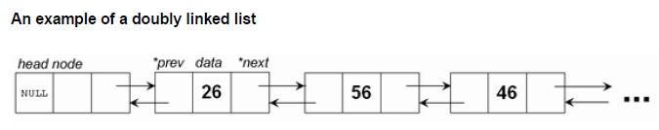
Doubly Linked list
In a singly Linked list one can move from the header node to any node in one direction only (left-right).
A doubly linked list is a two-way list because one can move in either direction. That is, either from left to right or from right to left.
It maintains two nexts or pointer. Hence it is called as doubly linked list.
Where, DATA field - stores the element or data, PREV- contains the address of its previous node, NEXT- contains the address of its next node.
PREV DATA NEXT
Structure of the node

Slide 30
Doubly Linked list operations
Insertion:
Insertion of a node at the front
Insertion of a node at any position in the list
Insertion of a node at the end
Deletion:
Deletion at front
Deletion at any position
Deletion at end
Display:
Displaying/Traversing the elements of a list

Slide 31
ptr
header
Before inserting a node at the beginning
1010
1010
NULL
10
2020
1010
20
1000
2020
30
2000
1000
40
NULL
1010
2020
1000
2000
NULL
50
NULL
2200
new
After inserting a node at the beginning
2200
10
2020
1010
20
1000
2020
30
2000
1000
40
NULL
1010
2020
1000
2000
Algorithm:
Create a new node
Read the item
new->data=item
ptr= header
new->next=ptr;
ptr->prev=new;
new->prev=NULL;
header=new;
NULL
50
1010
2200
new
header
2200

Slide 32
header
Before inserting a node at end of a list
ptr
1010
1010
ptr
NULL
10
2020
1010
20
1000
2020
30
2000
1000
40
NULL
1010
2020
1000
2000
NULL
50
NULL
After inserting a node
at end of a list
ptr
2000
2200
new
NULL
10
2020
1010
20
1000
2020
30
2000
1000
new
40
2200
1010
2020
1000
2000
Algorithm:
Create a new node
Read the item
new->data=item
ptr= header
while(ptr->next!=NULL)
ptr=ptr->next;
new->next=NULL;
new->prev=ptr;
ptr->next=new;
2000
50
NULL
2200
new

Slide 33
Insertion of a node at any position in the list
Algorithm:
1. create a node new
2. read item
3. new->data=item
4. ptr=header;
5. Read the position where the element is to be inserted
6. for(i=1;i<pos-1;i++)
6.1 ptr=ptr->next;
7. if(ptr->next = = NULL)
7.1 new->next = NULL;
7.2 new->prev=ptr;
7.3 ptr->next=new;
8. else
8.1 ptr1=ptr->next;
8.2 new->next=ptr1;
8.3 ptr1->prev=new;
8.4 new->prev=ptr;
8.5 ptr->next=new;
9. end

Slide 34
header
ptr
Before inserting a node at position 3
1010
1010
ptr
NULL
10
2020
1010
20
1000
2020
30
2000
1000
40
NULL
1010
2020
1000
2000
NULL
50
NULL
2200
new
After inserting a node at position 3
ptr
2020
ptr
ptr
header
1000
ptr1
1010
NULL
10
2020
1010
20
2200
2200
30
2000
1000
40
NULL
1010
2020
1000
2000
2020
50
1000
2200
new

Slide 35
header
1010
Before deleting a node at beginning
NULL
10
2020
1010
20
1000
2020
30
2000
1000
40
NULL
1010
2020
1000
2000
1010
ptr
ptr1
header
2020
After deleting a node at beginning
NULL
10
2020
NULL
20
1000
2020
30
2000
1000
40
NULL
1010
2020
1000
2000
Algorithm:
1.ptr=header
2.ptr1=ptr->next;
3.header=ptr1;
4.if(ptr1!=NULL)
1.ptr1->prev=NULL;
5. free(ptr);

Slide 36
header
1010
Before deleting a node at end
NULL
10
2020
1010
20
1000
2020
30
2000
1000
40
NULL
1010
2020
1000
2000
header
pt1
ptr
1010
After deleting a node at end
1000
2000
NULL
10
2020
1010
20
1000
2020
30
NULL
1000
40
NULL
1010
2020
1000
2000
Algorithm:
ptr=header
while(ptr->next!=NULL)
ptr=ptr->next;
end while
ptr1=ptr->prev;
ptr1->next=NULL;

Slide 37
Deletion at any position
4. if(ptr = = header)
//if the deleted item is first node
4.1 ptr1=ptr->next;
4.2 ptr1->prev=NULL;
4.3 header=ptr1;
4.4 end if
5.else
5.1 ptr1=ptr->prev;
5.2 ptr2=ptr->next;
5.3 ptr1->next=ptr2;
5.4 ptr2->prev=ptr1;
6. end else
7. end if
Algorithm:
1. ptr=header;
2. while(ptr->next!=NULL)
1.for(i=1;i<pos-1;i++)
1. ptr=ptr->next;
2.if(i = = pos-1)
1. break;
3. end while

Slide 38
header
Before deleting a node at position 3
ptr
1010
1010
ptr
NULL
10
2020
1010
20
1000
2020
30
2000
1000
40
NULL
1010
2020
1000
2000
4. if(ptr = = header)
//if the deleted item is first node
4.1 ptr1=ptr->next;
4.2 ptr1->prev=NULL;
4.3 header=ptr1;
4.4 end if
5.else
5.1 ptr1=ptr->prev;
5.2 ptr2=ptr->next;
5.3 ptr1->next=ptr2;
5.4 ptr2->prev=ptr1;
6. end else
7. end if
Algorithm:
1. ptr=header;
2. while(ptr->next!=NULL)
1.for(i=0;i<pos-1;i++)
1. ptr=ptr->next;
2.if(i = = pos-1)
1. break;
3. end while

Slide 39
header
Before deleting a node at position 3
ptr
1010
1010
ptr
NULL
10
2020
1010
20
1000
2020
30
2000
1000
40
NULL
1010
2020
1000
2000
After deleting a node at position 3
ptr
ptr
header
2020
ptr1
1000
ptr2
2000
1010
NULL
10
2020
1010
20
2000
2200
30
2000
2020
40
NULL
1010
2020
1000
2000

Slide 40
Displaying elements of a list
Algorithm:
ptr=header;
if(header = = NULL)
printf("The list is empty\n");
else
print “The elements in forward order: “
while(ptr!=NULL)
print “ptr->data”;
if(ptr->next = = NULL)
break;
ptr=ptr->next;
print “The elements in reverse order: “
while(ptr!=header)
if(ptr->next = = NULL)
print “ptr->data”;
else
print “ptr->data”;
ptr=ptr->prev;
print “ptr->data”;
3.end else
4. end else

Slide 41
ptr
header
1010
1010
NULL
10
2020
1010
20
1000
2020
30
2000
1000
40
NULL
1010
2020
1000
2000
Forward Order : 10 20 30 40
Reverse Order : 40 30 20 10

Slide 42
/*Program to implement operations of double Linked list*/
#include<stdio.h> #include<conio.h> #include<malloc.h>
void insertion(); void deletion(); void traverse(); int i,pos,item,choice;
struct node {
int data;
struct node *next;
struct node *prev;
}*new,*header,*ptr,*ptr1,*ptr2;
void main() {
header=NULL;
printf(" ***** MENU ****");
printf("\n1.Insertion \n2.Deletion \n3.Traverse \n4.Exit\n");
while(1) {
printf("\n\nEnter your choice: ");
scanf("%d",&choice);
switch(choice) {
case 1: insertion(); break;
case 2: deletion(); break;
case 3: traverse(); break;
case 4: exit();
default: printf("\nWrong choice");
}/* end of switch */
}/* end of while */
}/* end of main */

Slide 43
void insertion() {
ptr=header;
new=malloc(sizeof(struct node));
printf("\nEnter the item to be inserted: ");
scanf("%d",&item);
new->data=item;
if(header==NULL) {
new->prev=NULL;
new->next=NULL;
header=new;
}
else {
printf("\nSelect the place:");
printf("\n1.Start \n2.Middle \n3.End\n");
scanf("%d",&choice);
if(choice==1) {
new->next=ptr;
ptr->prev=new;
new->prev=NULL;
header=new;
}/* choice1 */

Slide 44
if(choice==2)
{
printf("\nEnter the position to place the new element: ");
scanf("%d",&pos);
for(i=1;i<pos-1;i++)
ptr=ptr->next;
if(ptr->next==NULL)
{
new->next=NULL;
new->prev=ptr;
ptr->next=new;
}
else
{
ptr1=ptr->next;
new->next=ptr1;
ptr1->prev=new;
new->prev=ptr;
ptr->next=new;
}
}/* choice2 */
if(choice==3)
{
while(ptr->next!=NULL)
ptr=ptr->next;
new->next=NULL;
new->prev=ptr;
ptr->next=new;
}
}/* end of else */
}/* end of insertion */

Slide 45
void deletion()
{
ptr=header;
if(header==NULL)
printf("The list is empty\n");
else
{
printf("\Select the place:");
printf("\n1.Start \n2.Middle \n3.End\n");
scanf("%d",&choice);
if(choice==1)
{
printf("\nThe deleted item is: %d",ptr->data);
ptr1=ptr->next;
header=ptr1;
if(ptr1!=NULL)
ptr1->prev=NULL;
}/* choice1 */

Slide 46
if(choice==2) {
printf("\nEnter the position to delete the element: ");
scanf("%d",&pos);
while(ptr->next!=NULL) {
for(i=0;i<pos-1;i++)
ptr=ptr->next;
if(i==pos-1)
break;
}//while
printf("\n\nThe deleted node is: %d",ptr->data);
if(ptr==header)//deleted item is starting node
{
ptr1=ptr->next;
ptr1->prev=NULL;
header=ptr1;
}//if
else {
ptr1=ptr->prev;
ptr2=ptr->next;
ptr1->next=ptr2;
ptr2->prev=ptr1;
}
}/* choice2 */
}/* end of else */
if(choice==3)
{
while(ptr->next!=NULL)
ptr=ptr->next;
printf("\n\nThe deleted node is: %d",ptr->data);
ptr1=ptr->prev;
ptr1->next=NULL;
}/* choice3 */
}/*end of deletion */

Slide 47
void traverse(){
ptr=header;
if(header==NULL)
printf("The list is empty\n");
else {
printf("\n\nThe elements in farword order: ");
while(ptr!=NULL) {
printf(" %d",ptr->data);
if(ptr->next==NULL) {
break;
}
ptr=ptr->next;
}/* end of while */
printf("\n\nThe elements in reverse order: ");
while(ptr!=header) {
if(ptr->next==NULL)
printf(" %d",ptr->data);
else
printf(" %d",ptr->data);
ptr=ptr->prev;
}/* end of while */
printf(" %d",ptr->data);
}/* end of else */
}/* end of traverse() */

Slide 48
Representing Stack with Linked List
Disadvantage of using an array to implement a stack or queue is the wastage of space.
Implementing stacks as Linked lists provides a feasibility on the number of nodes by dynamically growing stacks, as a Linked list is a dynamic data structure.
The stack can grow or shrink as the program demands it to.
A variable top always points to top element of the stack.
top = NULL specifies stack is empty.

Slide 49
Representing Stack with Linked List
In a linked stack, every node has two parts – one that stores data and another that stores the address of the next node.
The START pointer of the linked list is used as TOP.
If TOP is NULL then it indicates that the stack is empty.
1
7
3
4
2
6
5
X
TOP
Linked List Stack Visualization (usfca.edu)

Slide 50
Push Operation on a Linked Stack
Algorithm to PUSH an element in a linked stack
Step 1: Allocate memory for the new node and name it as New_Node
Step 2: SET New_Node->DATA = VAL
Step 3: IF TOP = NULL, then
SET New_Node->NEXT = NULL
SET TOP = New_Node
ELSE
SET New_node->NEXT = TOP
SET TOP = New_Node
[END OF IF]
Step 4: END
1
7
3
4
2
6
5
X
TOP
9
1
7
3
4
2
6
5
X
TOP

Slide 51
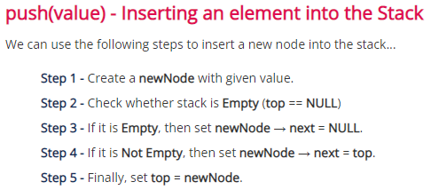
50
1500
1100
Example:
The following list consists of five cells, each of which holds a data object and a next to another cell.
A variable, top, holds the address of the first cell in the list.
40
1800
1500
30
1200
1800
20
1400
1200
top
10
NULL
1400

Slide 52
Pop Operation on a Linked Stack
Algorithm to POP an element from a stack
Step 1: IF TOP = NULL, then
PRINT “UNDERFLOW”
Goto Step 5
[END OF IF]
Step 2: SET PTR = TOP
Step 3: SET TOP = TOP ->NEXT
Step 4: FREE PTR
Step 5: END
9
1
7
3
4
2
6
5
X
TOP
1
7
3
4
2
6
5
X
TOP

Slide 53
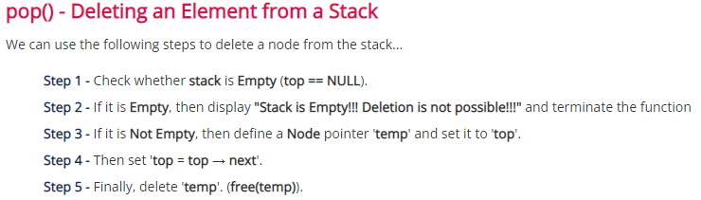

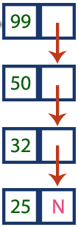
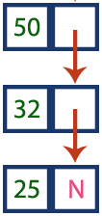
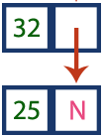
Pop()
Pop()

Slide 54
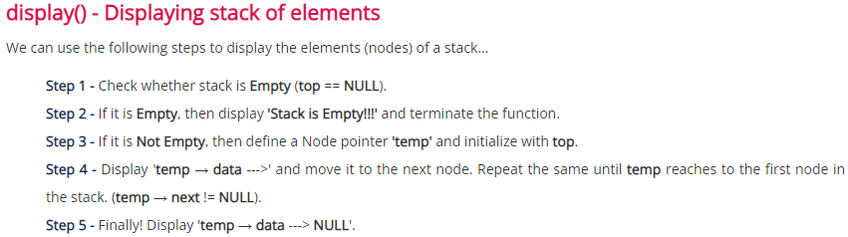
Display Operation on a Linked Stack
9
1
7
3
4
2
6
5
X
TOP

Slide 55
/* Write a c program to implement stack using Linked list */
#include<stdio.h> #include<conio.h> #include<malloc.h> #include<stdlib.h>
int push(); int pop(); int display(); int choice,i,item;
struct node {
int data;
struct node *next;
}*top,*new,*ptr;
main() { top=NULL;
printf("\n***Select Menu***\n");
while(1) {
printf("\n1.Push \n2.Pop \n3.Display \n4.Exit\n5.Count");
printf("\n\nEnter ur choice: ");
scanf("%d",&choice);
switch(choice) {
case 1: push(); break;
case 2: pop(); break;
case 3: display(); break;
case 4: exit(0);
case 5: count(); break;
default: printf("\nWrong choice");
}/* end of switch */
}/* end of while */
}/* end of main */

Slide 56
int push()
{
new=malloc(sizeof(struct node));
printf("\nEnter the item: ");
scanf("%d",&item);
new->data=item;
if(top = = NULL)
{
new->next=NULL;
}
else
{
new->next=top;
}
top=new;
return;
}/* end of insertion */
int pop()
{
if(top = = NULL)
{
printf("\n\nStack is empty");
return;
}//if
else
{
printf("\n\nThe deleted element is: %d",top->data);
top=top->next;
}
return;
}/* end of pop() */

Slide 57
int count()
{
int count=1;
ptr=top;
if(top = = NULL)
{
printf("\nThe list is empty");
return;
}
while(ptr->next!=NULL)
{
++count;
ptr=ptr->next;
}
printf("\n\nThe number of elements in the stack are: %d",count);
return;
}/* end of count */
int display()
{
ptr=top;
if(top = = NULL)
{
printf("\nThe list is empty");
return;
}
printf("\nThe elements in the stact are: ");
while(ptr!=NULL)
{
printf("\n %d",ptr->data);
ptr=ptr->next;
}/* end of while */
return;
}/* end of display() */

Slide 58
Representing Queue with Linked List
New items are added to the end of the list.
Removing an item from the queue will be done from the front.
A pictorial representation of a queue being implemented as a linked list is given below.
The variables front points to the front item in the queue and rear points to the last item in the queue.
front
rear
10
1800
20
1200
30
1400
40
NULL
1500
1800
1200
1400

Slide 59
Operations on Queue with Linked List
Insertion - Enqueue
Deletion – Dequeue
Display

Slide 60
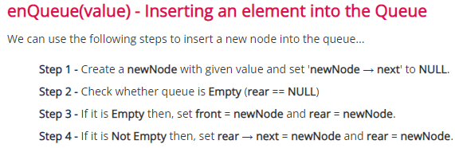
Insertion Operation on a Linked Queue
newNode
50 | NULL
2000
front = rear = newNode
Case 1 : Queue is empty // Front = NULL or rear = NULL
50 | NULL
2000
front
rear
newNode
Case 2 : Queue is not empty
50 | 2500
50
50 | NULL
2000
50 | 1500
NULL
1400
1500
2500
2000

Slide 61
Deletion Operation on a Linked Queue
dequeue()
Step 1: Check whether the queue is empty (front = NULL)
Step 2: If Queue is empty, then deletion is not possible.
Step 3: Else if, Queue is not empty,
Step 3.1: Check if Queue contains only one element (front = rear), then front = rear = NULL
Step 3.2: Else, temp = front, front = front->data, free(temp)
front
rear
Case 1 : Queue is not empty
temp
50 | 2500
2000
50 | 1500
50
50 | NULL
1400
1500
2500
2000
front
rear
Case 2 : Queue has only one element
temp = front
front = rear = NULL
free(temp)
50 | NULL
2000

Slide 62
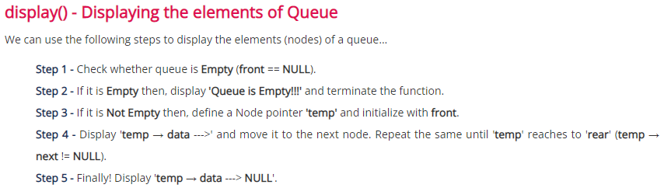
Display Operation on a Linked Queue

Slide 63
/*Write a c program to implement queue using nexted list*/
#include<stdio.h> #include<conio.h> #include<malloc.h>
#include<stdlib.h> int choice,i,item;
struct node {
int data;
struct node *next;
}*front,*rear,*new,*ptr;
main() {
front=NULL;
rear=NULL;
printf("\n\n MENU");
printf("\n1.Enqueue \n2.Dequeue \n3.Display \n4.Exit");
while(1) {
printf("\nEnter your choice: ");
scanf("%d",&choice);
switch(choice) {
case 1:enqueue(); break;
case 2:dequeue(); break;
case 3:display(); break;
case 4:exit(0);
default:printf("\nwrong choice");
}/*end of switch */
}/*end of while */
}/*end of main */

Slide 64
int enqueue()
{
new=malloc(sizeof(struct node));
printf("\nenter the item");
scanf("%d",&item);
new->data=item;
new->next=NULL;
if(front==NULL)
{
front=new;
}
else
{
rear->next=new;
}
rear=new;
return;
}/*end of enqueue */
display()
{
if(front==NULL)
printf("\nThe list is emtpy");
else
{
for(ptr=front;ptr!=NULL;ptr=ptr->next)
printf(" %d",ptr->data);
}
return;
}/* end of display */

Slide 65
dequeue()
{
if(front==NULL)
printf("\nThe list is empty");
else
if(front==rear) /*list has single element*/
{
printf("\nThe deleted element is: %d",front->data);
front=rear=NULL;
}
else
{
printf("\nThe deleted element is: %d",front->data);
front=front->next;
}
return;
}/*end of dequeue*/

Slide 66
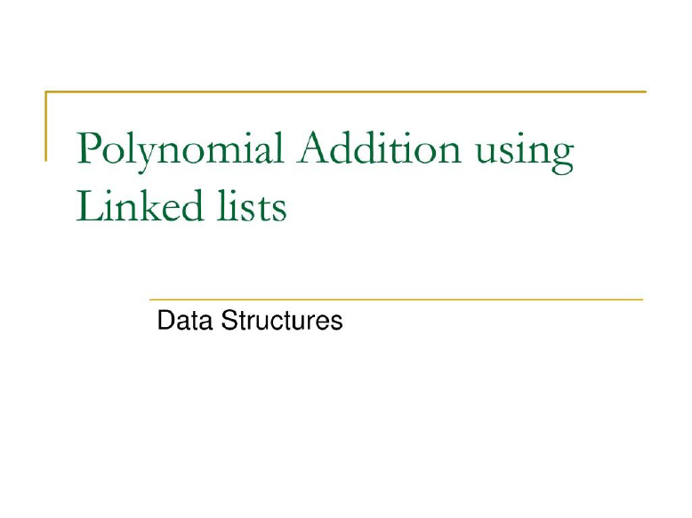

Slide 67
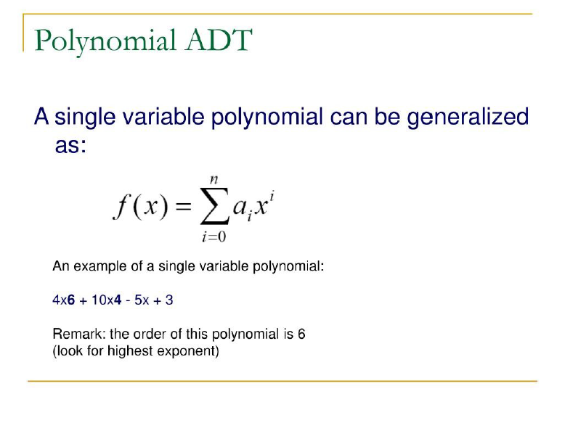
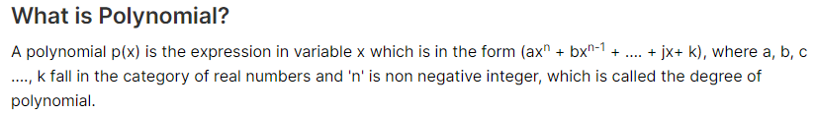

Slide 68
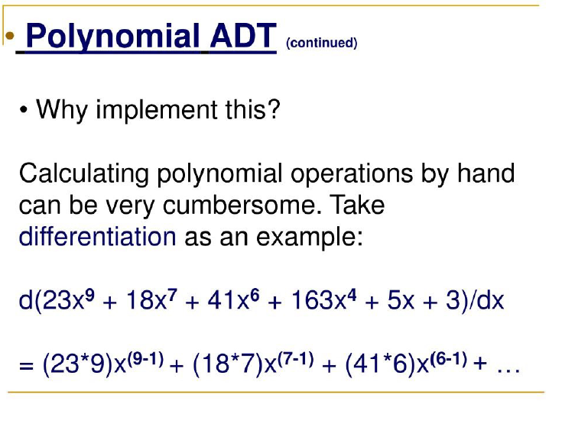

Slide 69
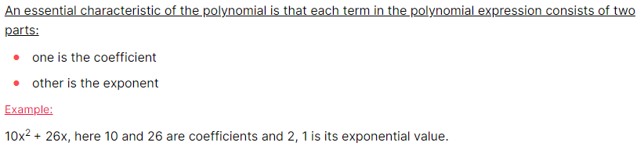
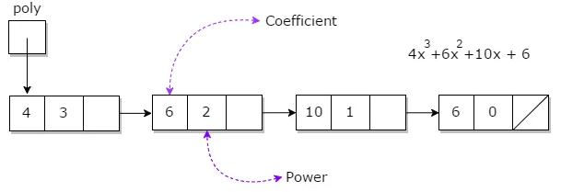
Polynomial ADT
Representation in Linked List

Slide 70
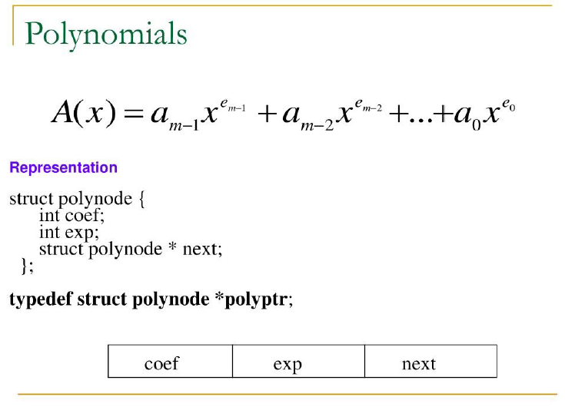

Slide 71
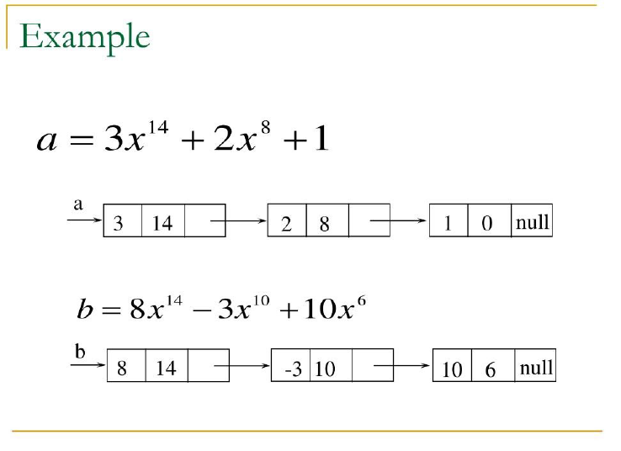

Slide 72
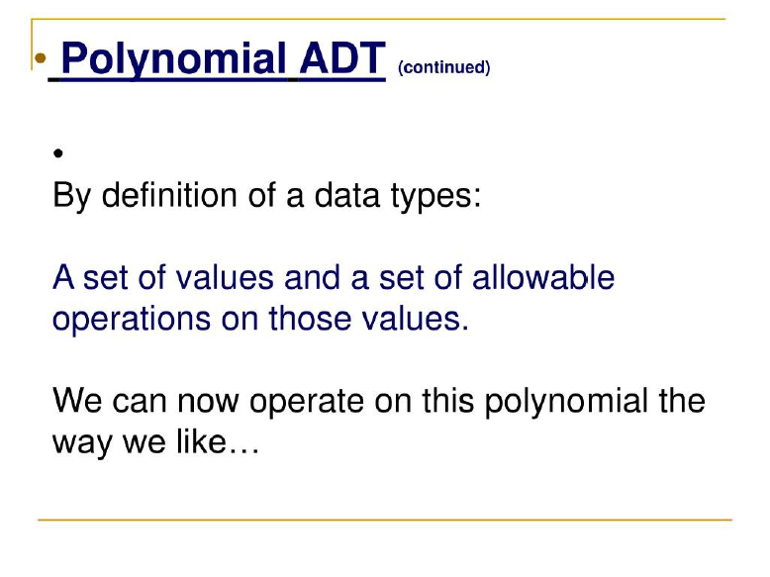

Slide 73
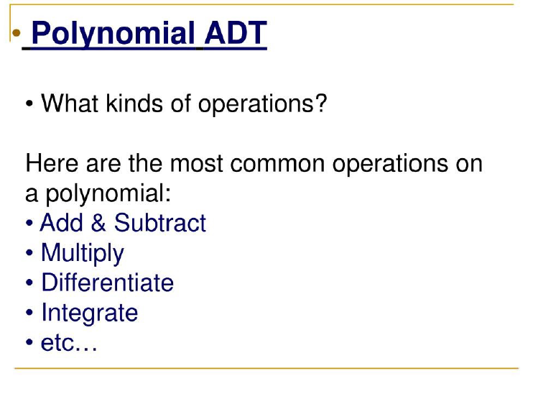

Slide 74
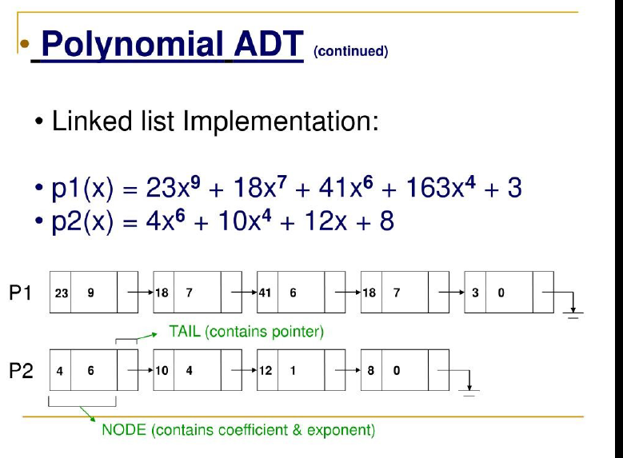

Slide 75
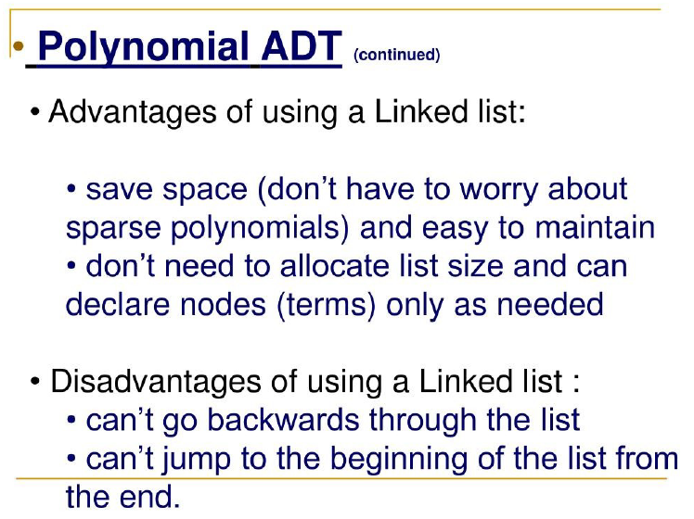

Slide 76
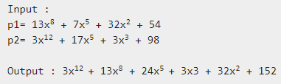
Polynomial Addition
To add two polynomials, we can add the coefficients of like terms and generate a new linked list for the resulting polynomial.

Slide 77
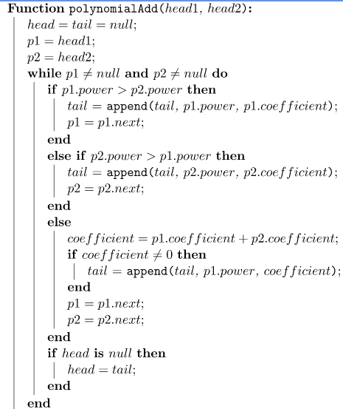
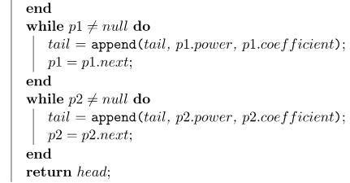
Polynomial Addition
p1
p1
p1
head1
13 | 8
7 | 5
32 | 2
52 | 0 | NULL
p2
p2
p2
p2
head2
3 | 12
17 | 5
3 | 3
98 | 0 | NULL
Step1: head = tail = null //new polynomial
Step2: p1 = head1, p2 = head2
Step3: Traverse both polynomials till either one poly reaches end
head
tail
tail
tail
tail
tail
3 | 12
13 | 8
24 | 5
3 | 3

Slide 78
Polynomial Addition
p1
p1
head1
13 | 8
7 | 5
32 | 2
52 | 0 | NULL
p2
head2
3 | 12
17 | 5
3 | 3
98 | 0 | NULL
Step1: head = tail = null //new polynomial
Step2: p1 = head1, p2 = head2
Step3: Traverse both polynomials till either one poly reaches end
head
tail
3 | 12
13 | 8
24 | 5
3 | 3
tail
tail
32 | 2
152 | 0 | NULL

Slide 79
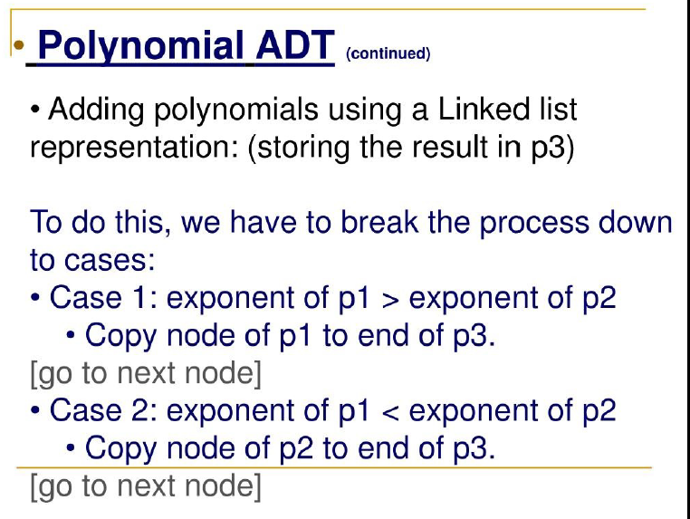

Slide 80
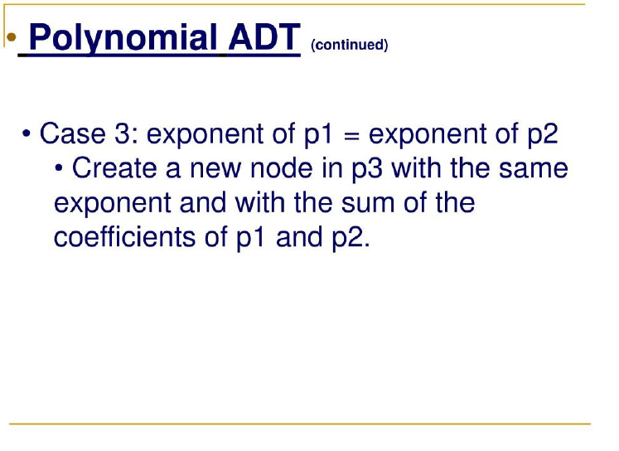

Slide 81
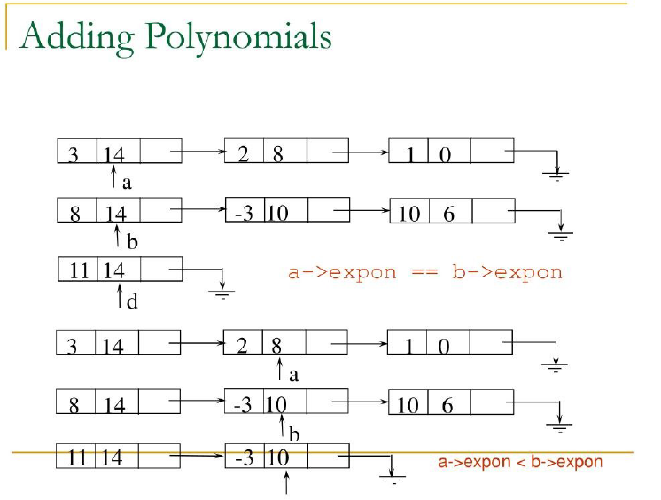

Slide 82
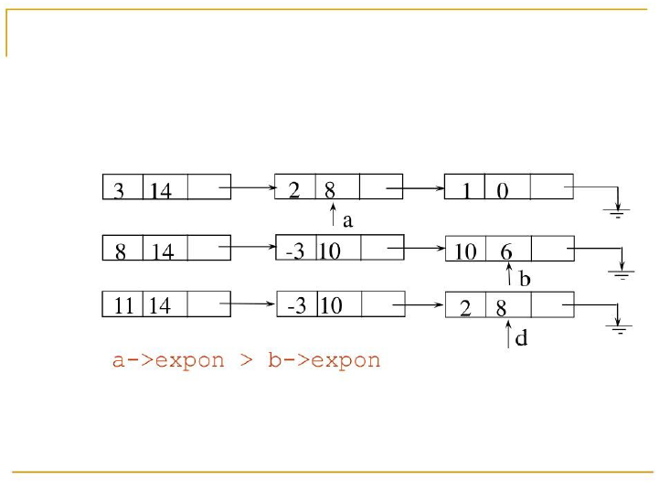

Slide 83
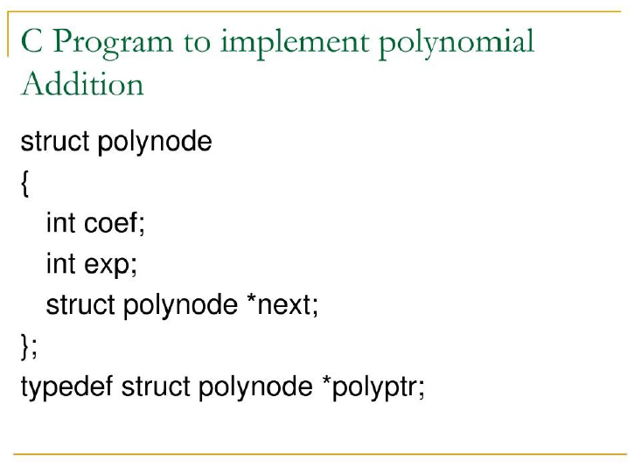

Slide 84
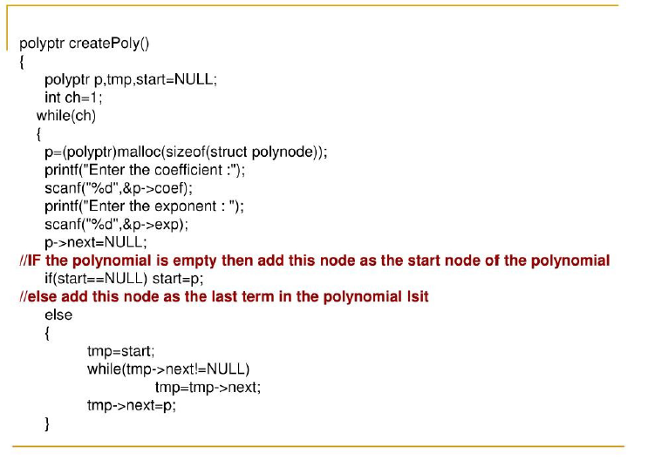

Slide 86
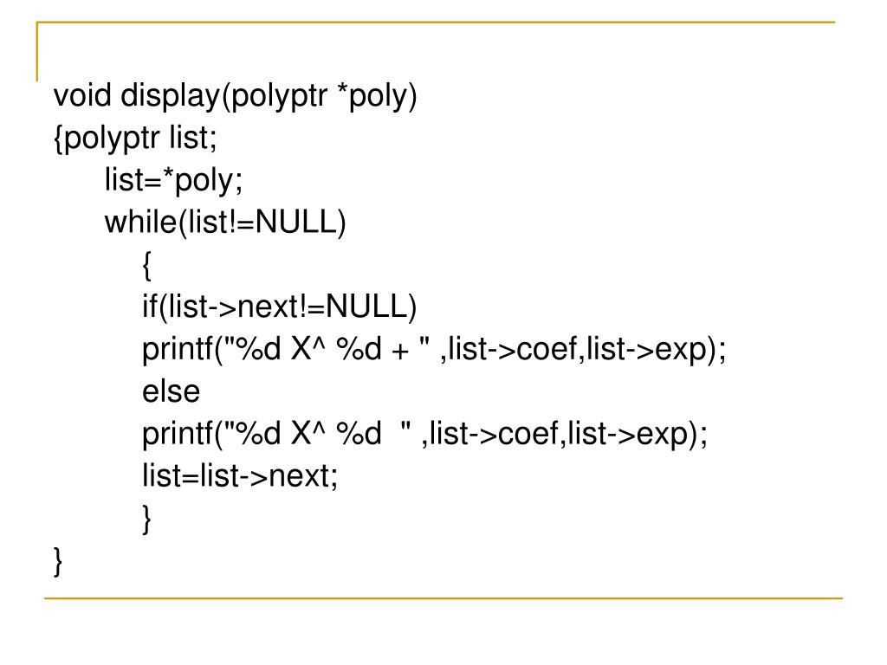

Slide 87
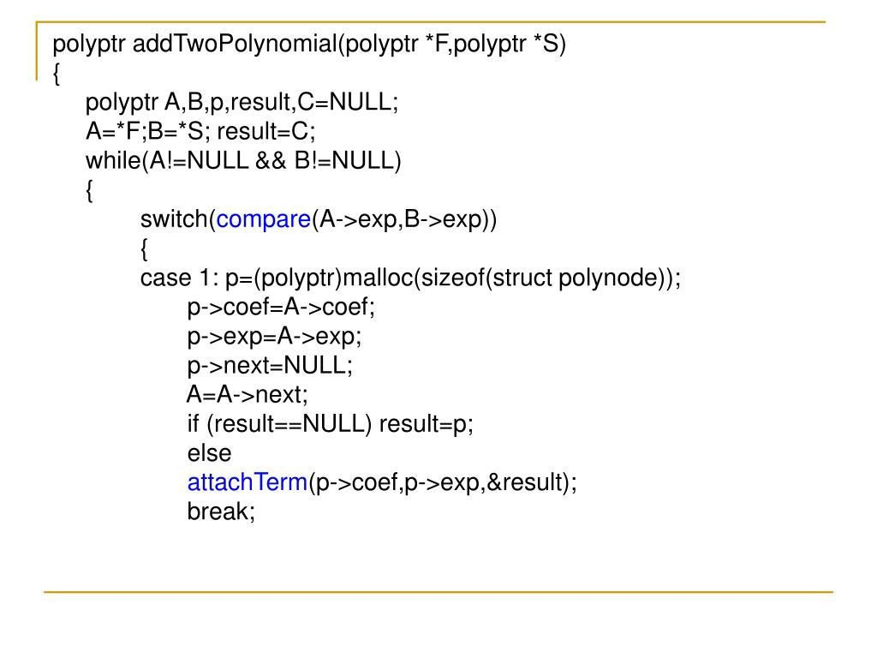

Slide 88
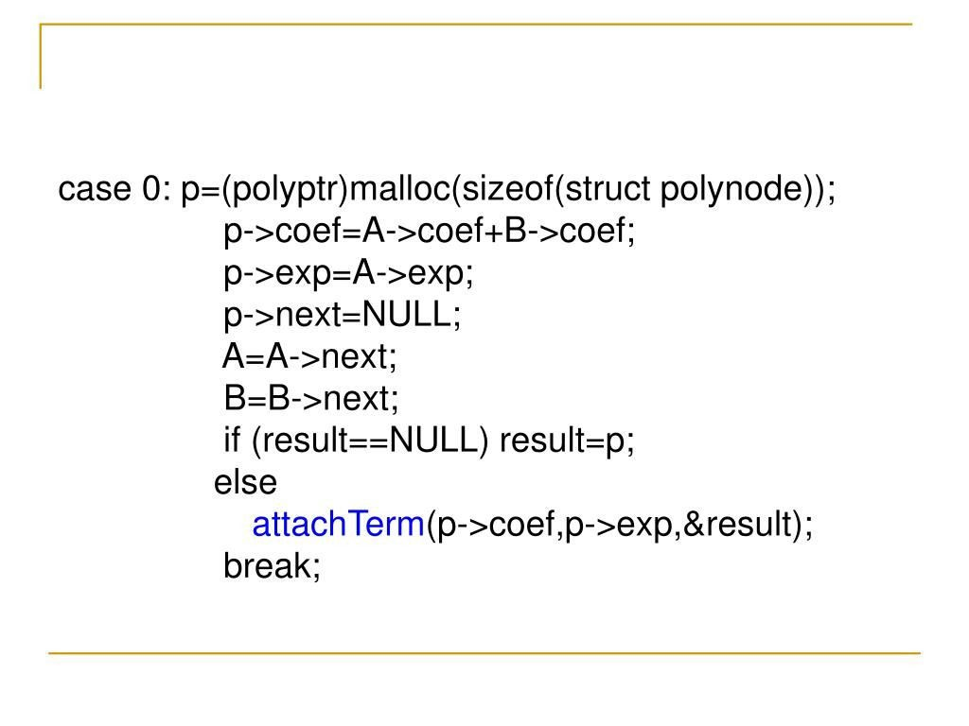

Slide 89
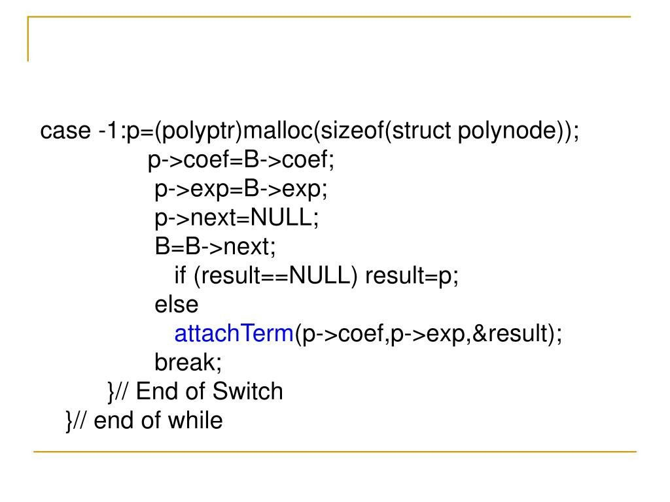

Slide 90
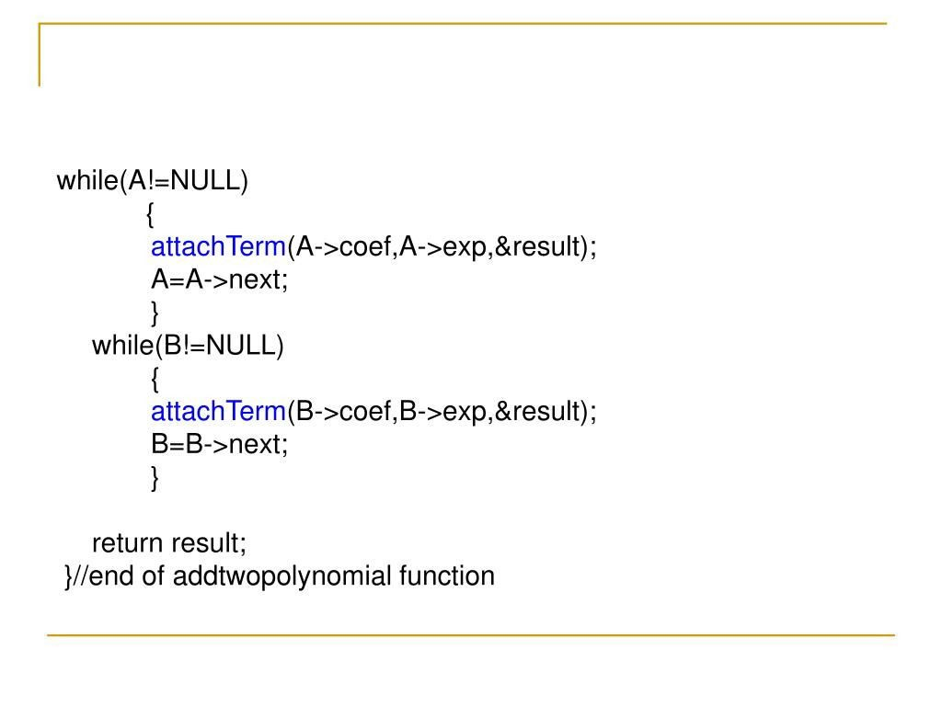

Slide 91
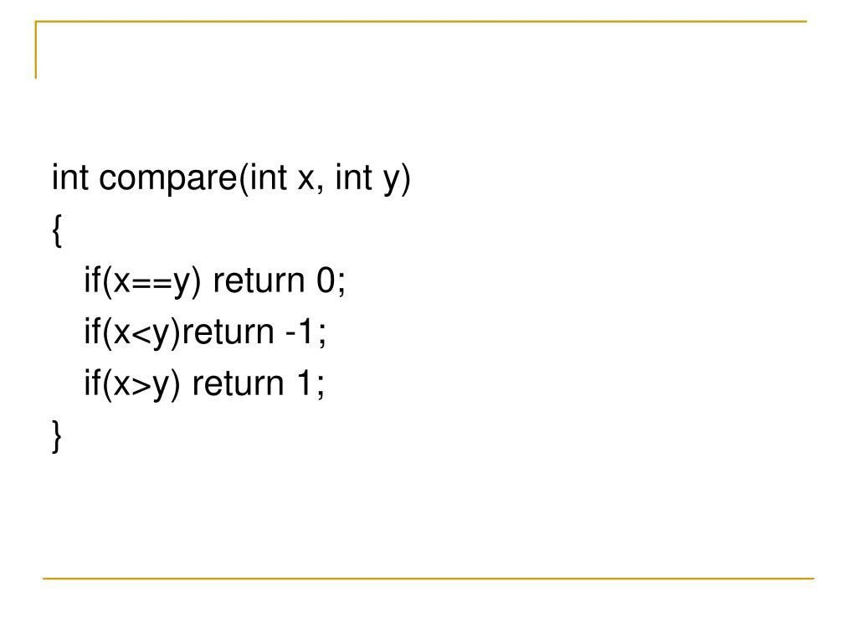

Slide 92
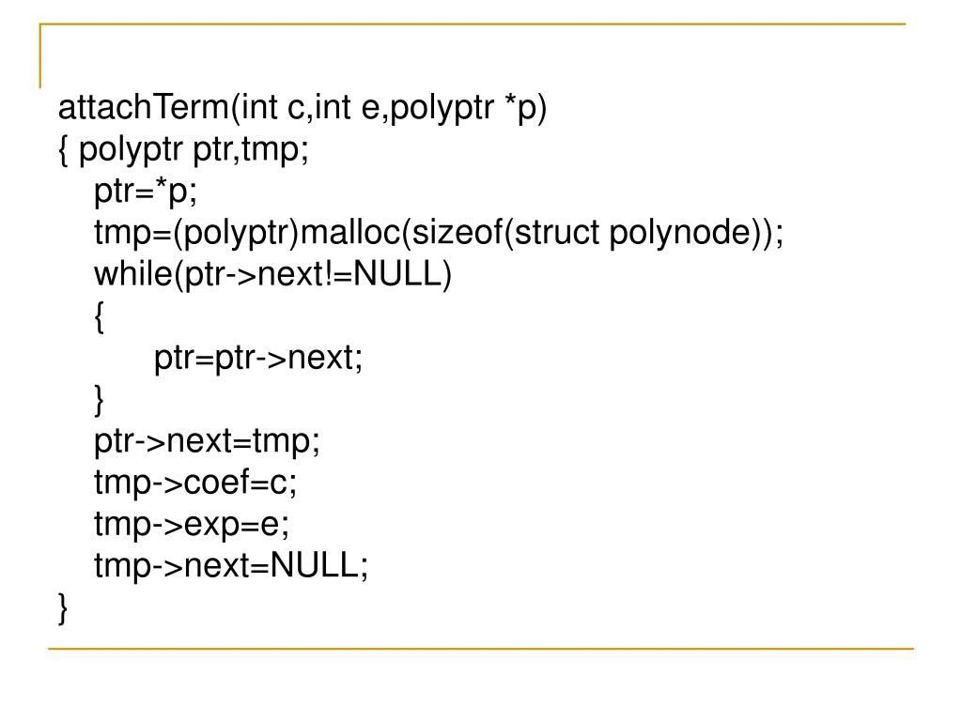

Slide 93
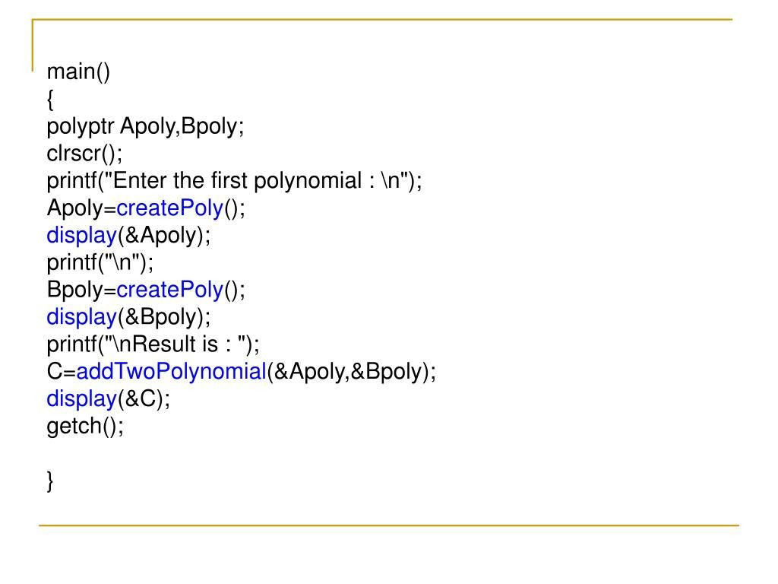

Slide 94
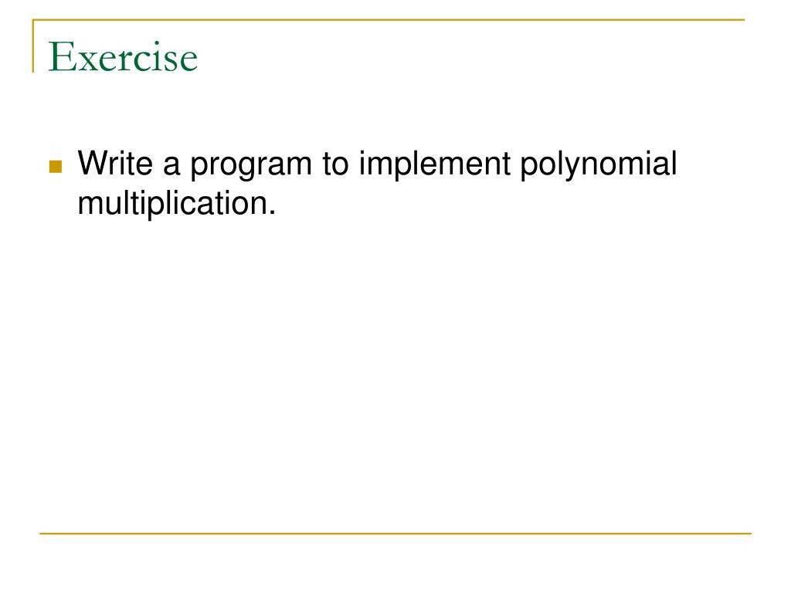

Slide 95
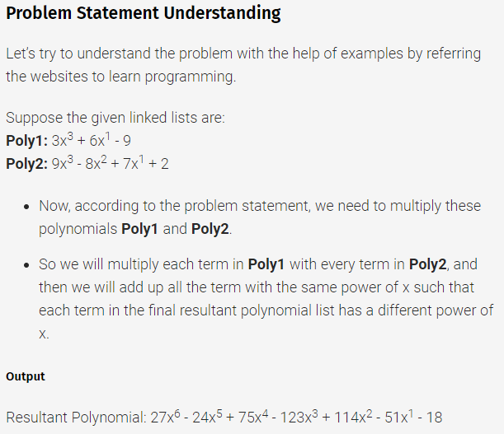
Polynomial multiplication

Slide 96
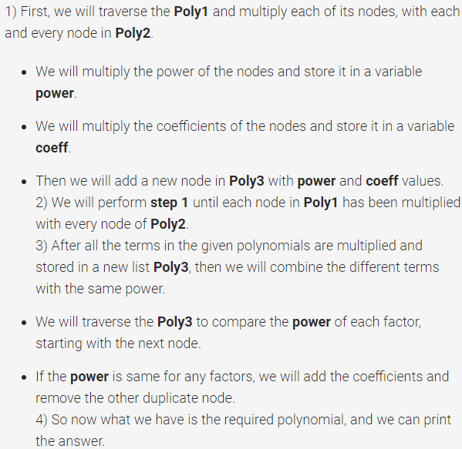
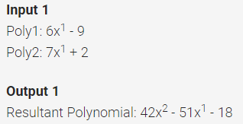
Polynomial multiplication

Slide 97




Polynomial multiplication
Step 1:
Step 2:
Step 3:
Step 4:

